Slide 1


Slide 2





Yuewan Sun sunyuewan2022@utexas.edu
SIDI-X
DesignQA
Multimodal Large Language Models
Grounded in Engineering Documentation
17 August 2025
Bam Thongmak pt8527@utexas.edu
SIDI LAB
System Integration & Design Informatics Laboratory

Slide 3
Problem Statement
DesignQA: Multimodal Large Language Models Grounded in Engineering Documentation
Goals: Develop an LLM agent to assist designers with
Design requirements document comprehension
Multimodal synthesis
“Design according to technical document is complex & tedious”

Slide 4
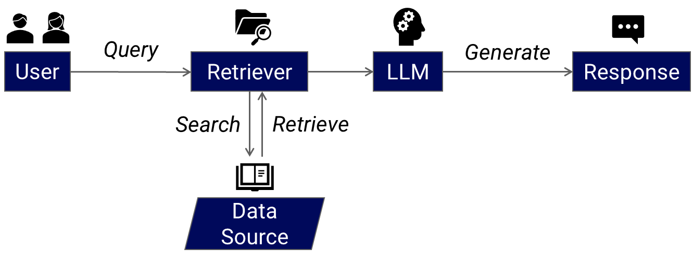
Retrieval-Augmented Generation

Slide 5

LLM: meta-llama/Llama-3.2-11B-Vision- Instruct
Multimodal model
Optimized for visual recognition and image reasoning
Embedding model: BAAI/bge-large-en-v1.5
Outputs 1,024-dimensional embeddings
Uses cosine similarity with L2-normalized vectors
Experimental Configuration
Notes:
Cosine similarity compares the direction of vectors

Slide 6
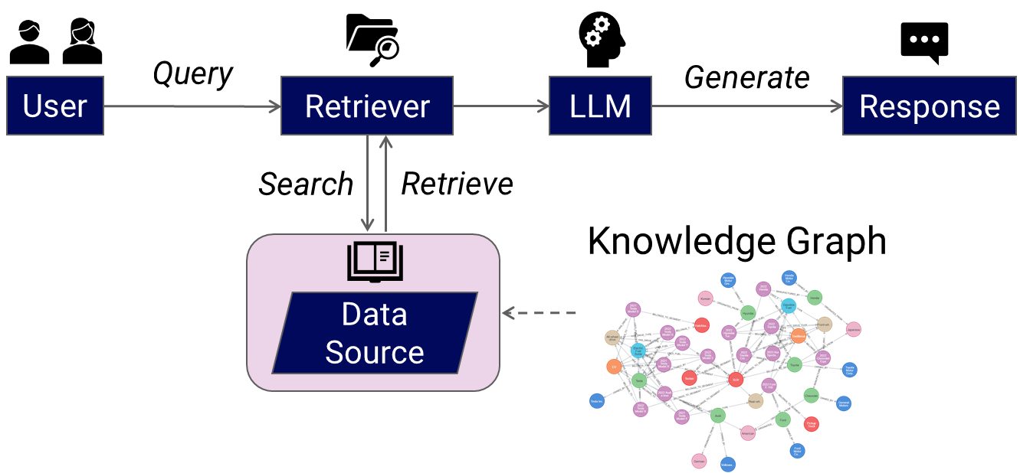
Retrieval-Augmented Generation

Slide 7
Knowledge Graph
Graph schema
Text chuck
HAS_KEYWORDS_IN
CONTAINS_RULE
Cluster keywords embedding
Rule number

Slide 8
Knowledge Graph
Graph schema
Text chuck
"GR.1.4.2 The vehicle should have high performance and be sufficiently durable to successfully complete all the events at the Formula SAE competitions. GR.1.4.3 A…”
CONTAINS_RULE
Cluster keywords embedding
Rule number

Slide 9
Knowledge Graph
Graph schema
Text chuck
HAS_KEYWORDS_IN
Cluster keywords embedding
Cluster 239: Performance, performance, Performance advantage, high performance, Bond Performance
Cluster 240: terminals, Cell terminal
…
Rule number

Slide 10
Knowledge Graph
Graph schema
Text chuck
CONTAINS_RULE
Cluster keywords embedding
Rule number
GR.1.4.2, EV.5.2, VE.2.5.1,...

Slide 11
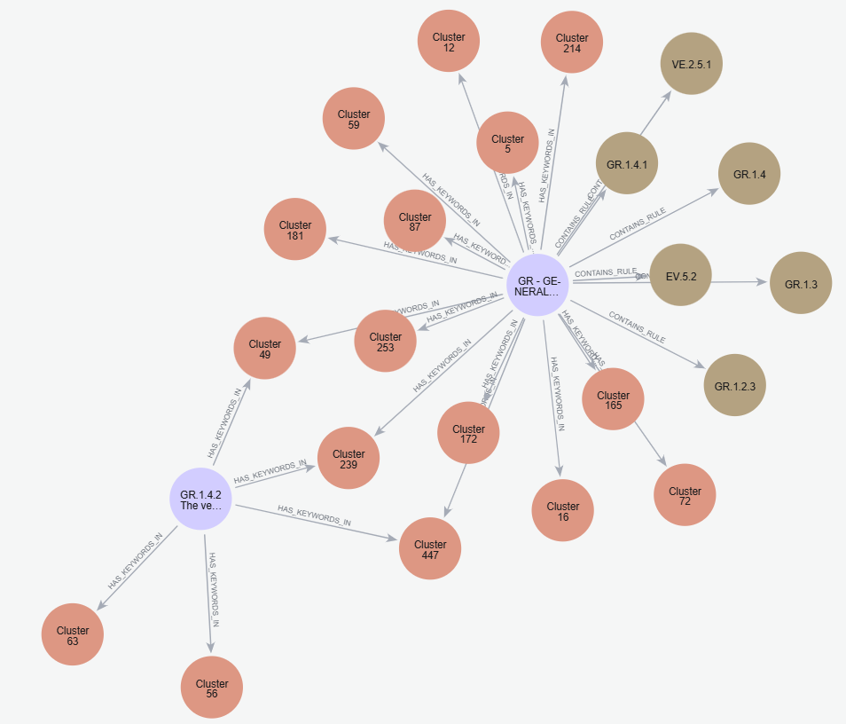
Knowledge Graph
Graph schema
Text chuck
HAS_KEYWORDS_IN
CONTAINS_RULE
Cluster keywords embedding
Rule number

Slide 12
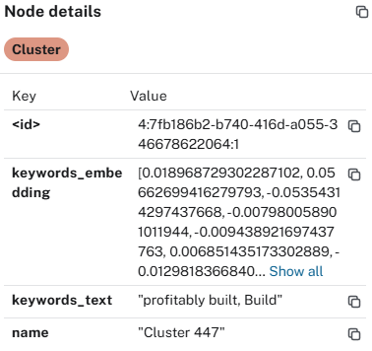
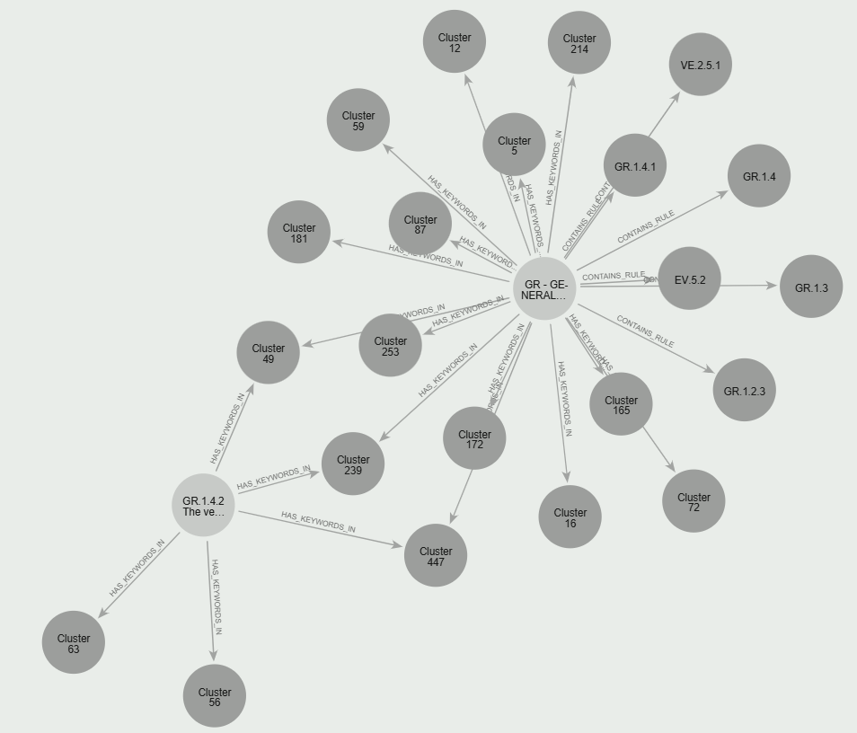
Knowledge Graph
Graph schema
Text chuck
HAS_KEYWORDS_IN
CONTAINS_RULE
Cluster keywords embedding
Rule number

Slide 13
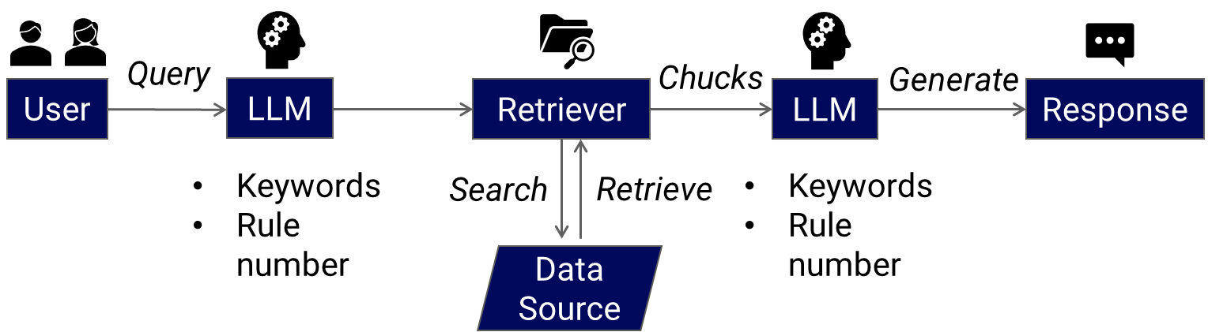
Rule Extraction

Slide 14
Rule Extraction
Retrieval
Compilation
Q: Tell me rule V.1.2 verbatim.
Q: List all the rules relevant to suspension.
Text chuck
Text chuck
HAS_KEYWORDS_IN
CONTAINS_RULE
HAS_KEYWORDS_IN
CONTAINS_RULE
Cluster keywords embedding
Rule number
Cluster keywords embedding
Rule number
Compilation Score 1 (Avg F1 Rules): 0.18940
(3 candidates)
Retrieval Score (Avg F1 BoW): 0.91017
Compilation Score 2 (Avg F1 Rules): 0.34202
(10 candidates)

Slide 15
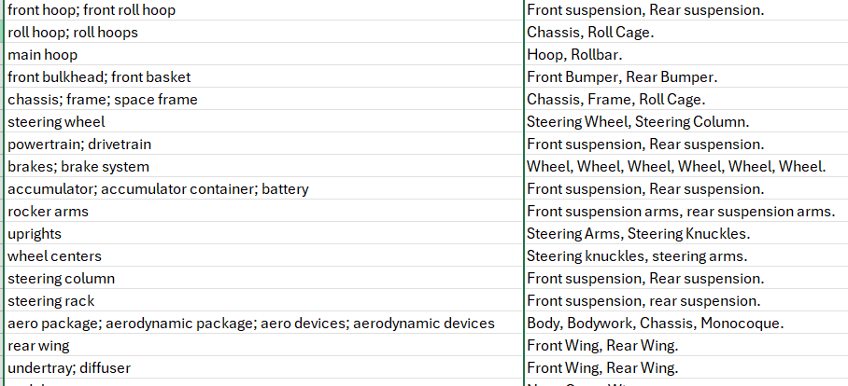
Rule Comprehension
Input the question and attach the image
Definition Score (Avg F1 BoC): 0.43547

Slide 16
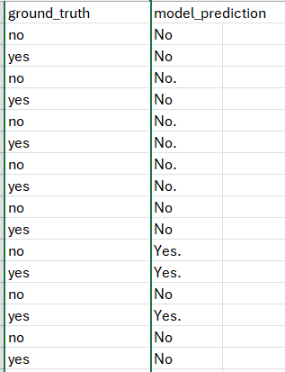
Rule Comprehension
Llama often outputs ‘No’.
Presence Score (Avg Accuracy): 0.56451

Slide 17
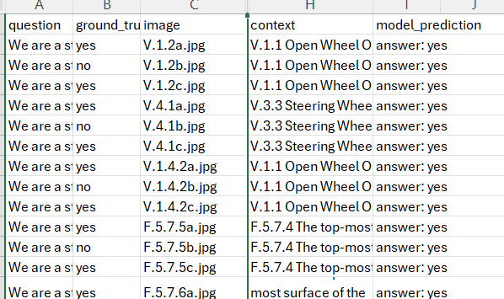
Rule Compliance – Dimension QA
Retrieve context in knowledge graph
Input question, image and context to LLM
Llama often outputs ‘Yes’.
Dimension Score : 0.683333

Slide 18
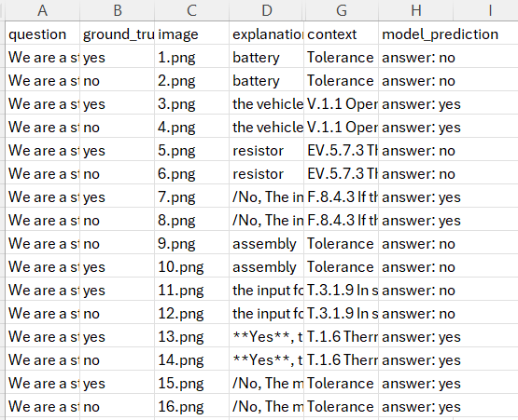
Rule Compliance – Functional Performance QA
Retrieve context in knowledge graph
Input question, image and context to LLM
Llama often outputs ‘Yes’.
Functional Performance Score: 0.5

Slide 19
Future Improvements
Collect Image Data to train LLM
Hierarchy encoding
LLM-retrieve
Potential Applications
Knowledge Management
Rule evolution tracking
Semantic search across domains
Design support with CAD / Simulation integration

Slide 20
Thank you!
Q & A

